Slide 1

Acid rain modeling
Advanced mechanic fluid project
supervisors:
Dr. Mostofi
Mr. Nosrati
Researcher:
Masoud Abdi

Slide 2
Overview
Introduction
Reactions
Implicit method
Modeling
pH changes

Slide 3
Introduction
Industrialization
Fossil fuels
Air pollution
Acid rains

Slide 4
Introduction Effects of acid rain
Chemical biographical cycles
Ecosystems
Human health

Slide 5
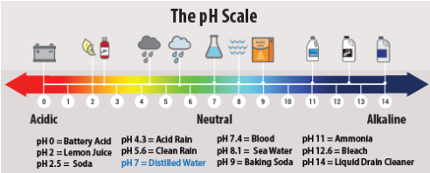
Introduction What is acid rain?
H⁺ ionic concentration > 2.5 eq.l⁻¹
pH < 5.6

Slide 6
Introduction Sources of acid rain
O₃
CO₂
NO_{x}
SO₄

Slide 7
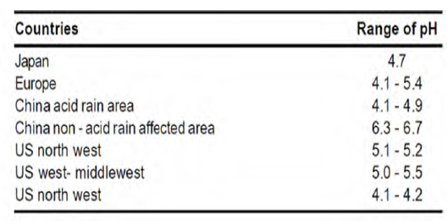
Introduction Acid rain in the world

Slide 8
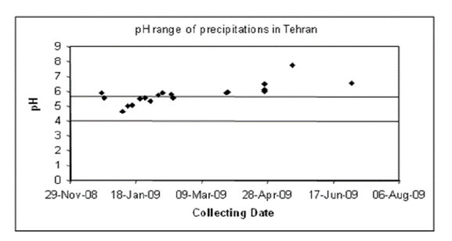
Introduction Acid rain in Tehran

Slide 9
Reactions The reaction including sulfur
2SO₂+O₂ 2SO₃²⁻
SO₃²⁻+H₂O H₂SO₄
SO₂+H₂O H₂SO₃
H₂SO₃⁻+O₃ SO₄²⁺+H⁺+O₂

Slide 10
Reactions The reaction including nitrogen
N₂+O₂ 2NO
2NO+O₂ 2NO₂
4NO₂+O₂+2H₂O 4HNO₃
O₃+NO₂ NO₃+O₂
NO₃+NO₂ N₂O₅
N₂O₅+H₂O 2HNO₃

Slide 11

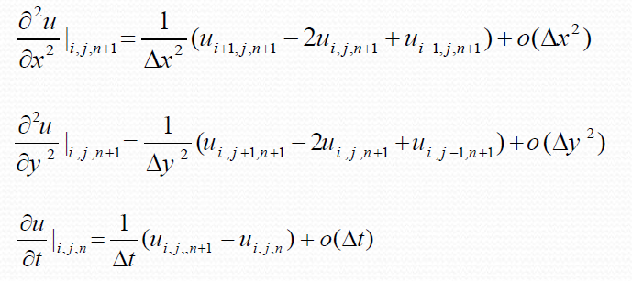
Implicit method
Equation:
Use forward difference:

Slide 12

Implicit method
Stability condition
Implicit method is unconditionally stable:

Slide 13

Modeling
1. Modeling of acid rain drop (CO₂)
C_{i}= 420 ppm
D= 1.91×10⁻⁹ m²/s
K= 0.037 s⁻¹
Time range=0-10 s

Slide 14
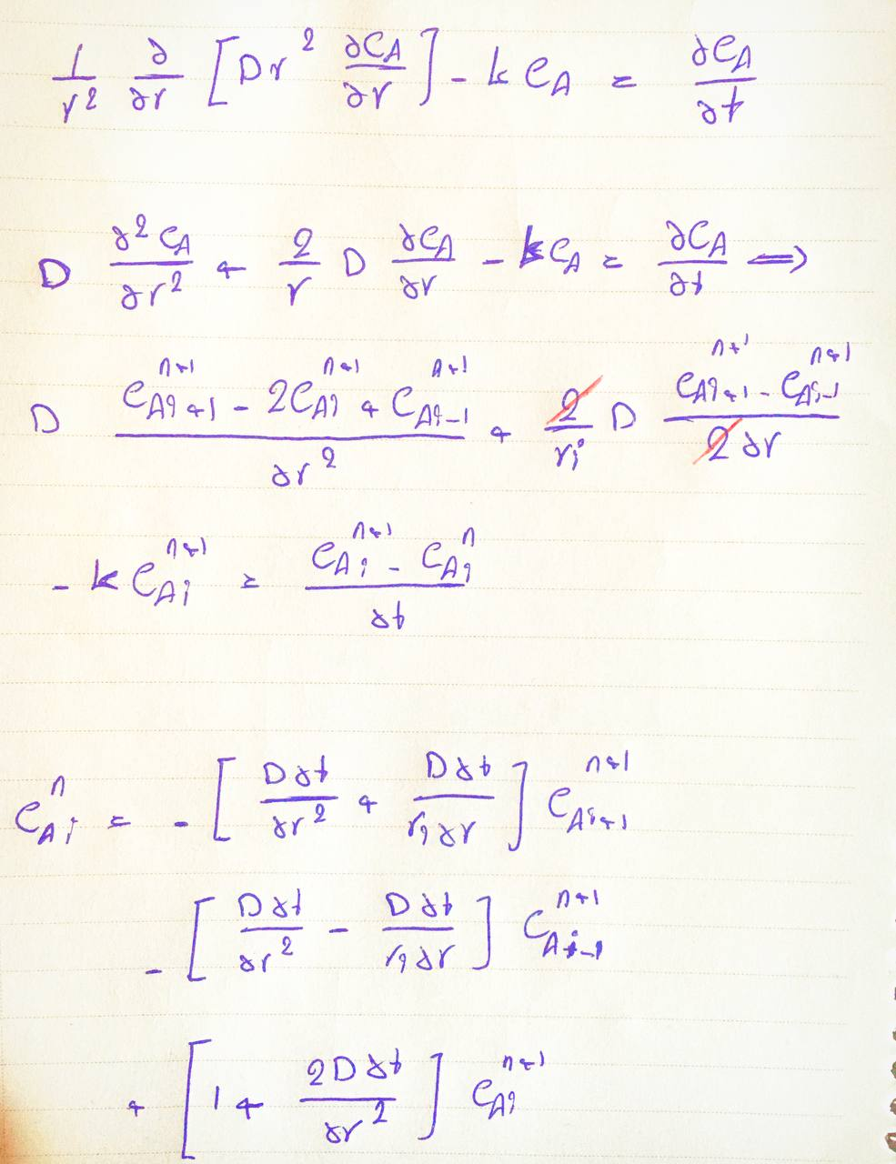
Modeling Modeling of acid rain drop

Slide 15

Modeling
Boundary and Initial Condition
@ r = R C_{A}= C_{Ai}
@ r = 0 $\frac{∂C_{A}}{∂r}$ = 0
@ t = 0 C_{A}= 0

Slide 16
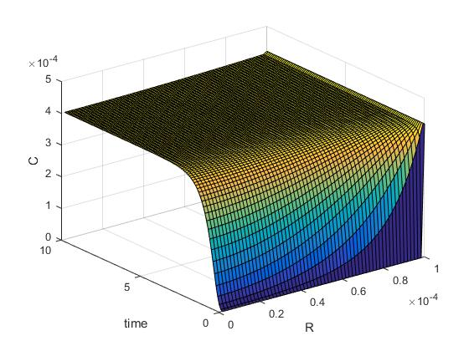
Modeling
Modeling result
Solution method: Implicit

Slide 17
Modeling
2. Modeling of acid rain drop (SO₂)
C_{i}= 0.804 ppm
D= 1.91×10⁻⁹ m²/s
K= 52.54 s⁻¹
Time range=0-555 s

Slide 18
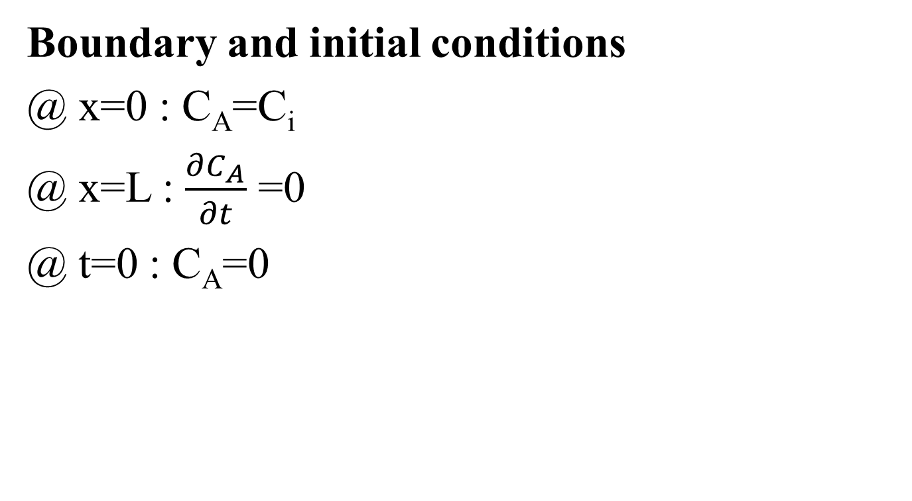
Modeling

Slide 19
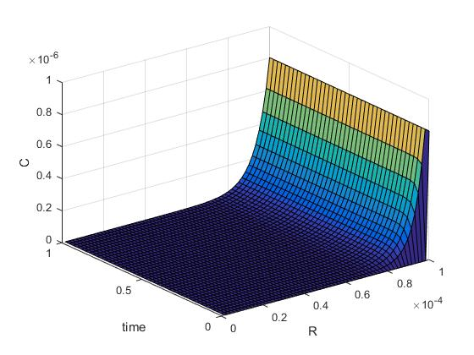
Modeling
Modeling result
Solution method: Implicit

Slide 20
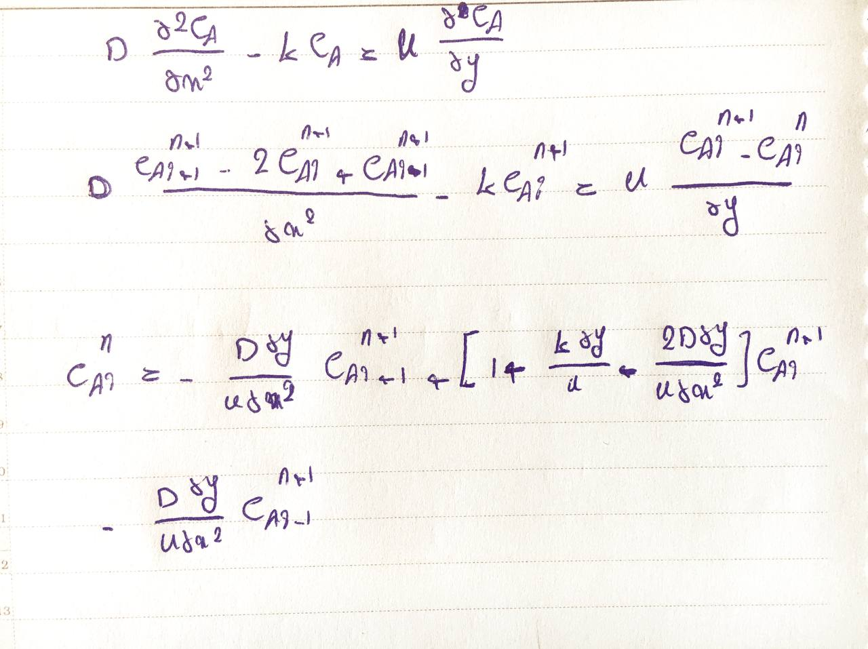
Modeling Modeling of acid rain steady falling film

Slide 21

Modeling Modeling of acid rain steady falling film (CO₂)
C_{i}= 420 ppm
D= 1.91×10⁻⁹ m²/s
K= 0.037 s⁻¹
u= 9 m/s

Slide 22
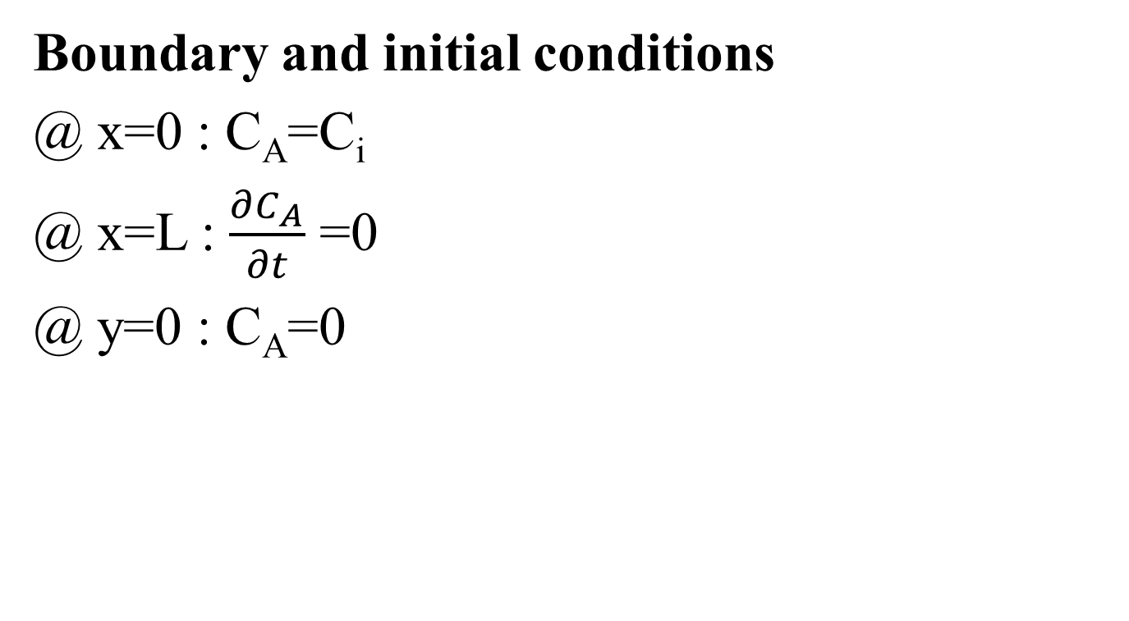
Modeling

Slide 23
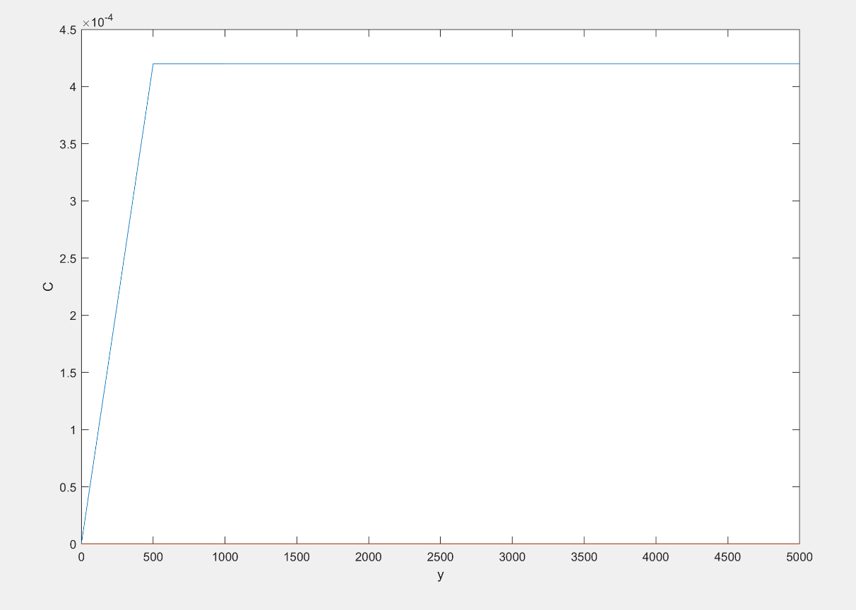
Modeling
Modeling result
Solution method: Implicit

Slide 24
Modeling Modeling of acid rain steady falling film (SO₂)
C_{i}= 0.804 ppm
D= 1.91×10⁻⁹ m²/s
K= 52.54 s⁻¹
u= 9 m/s

Slide 25
Modeling

Slide 26
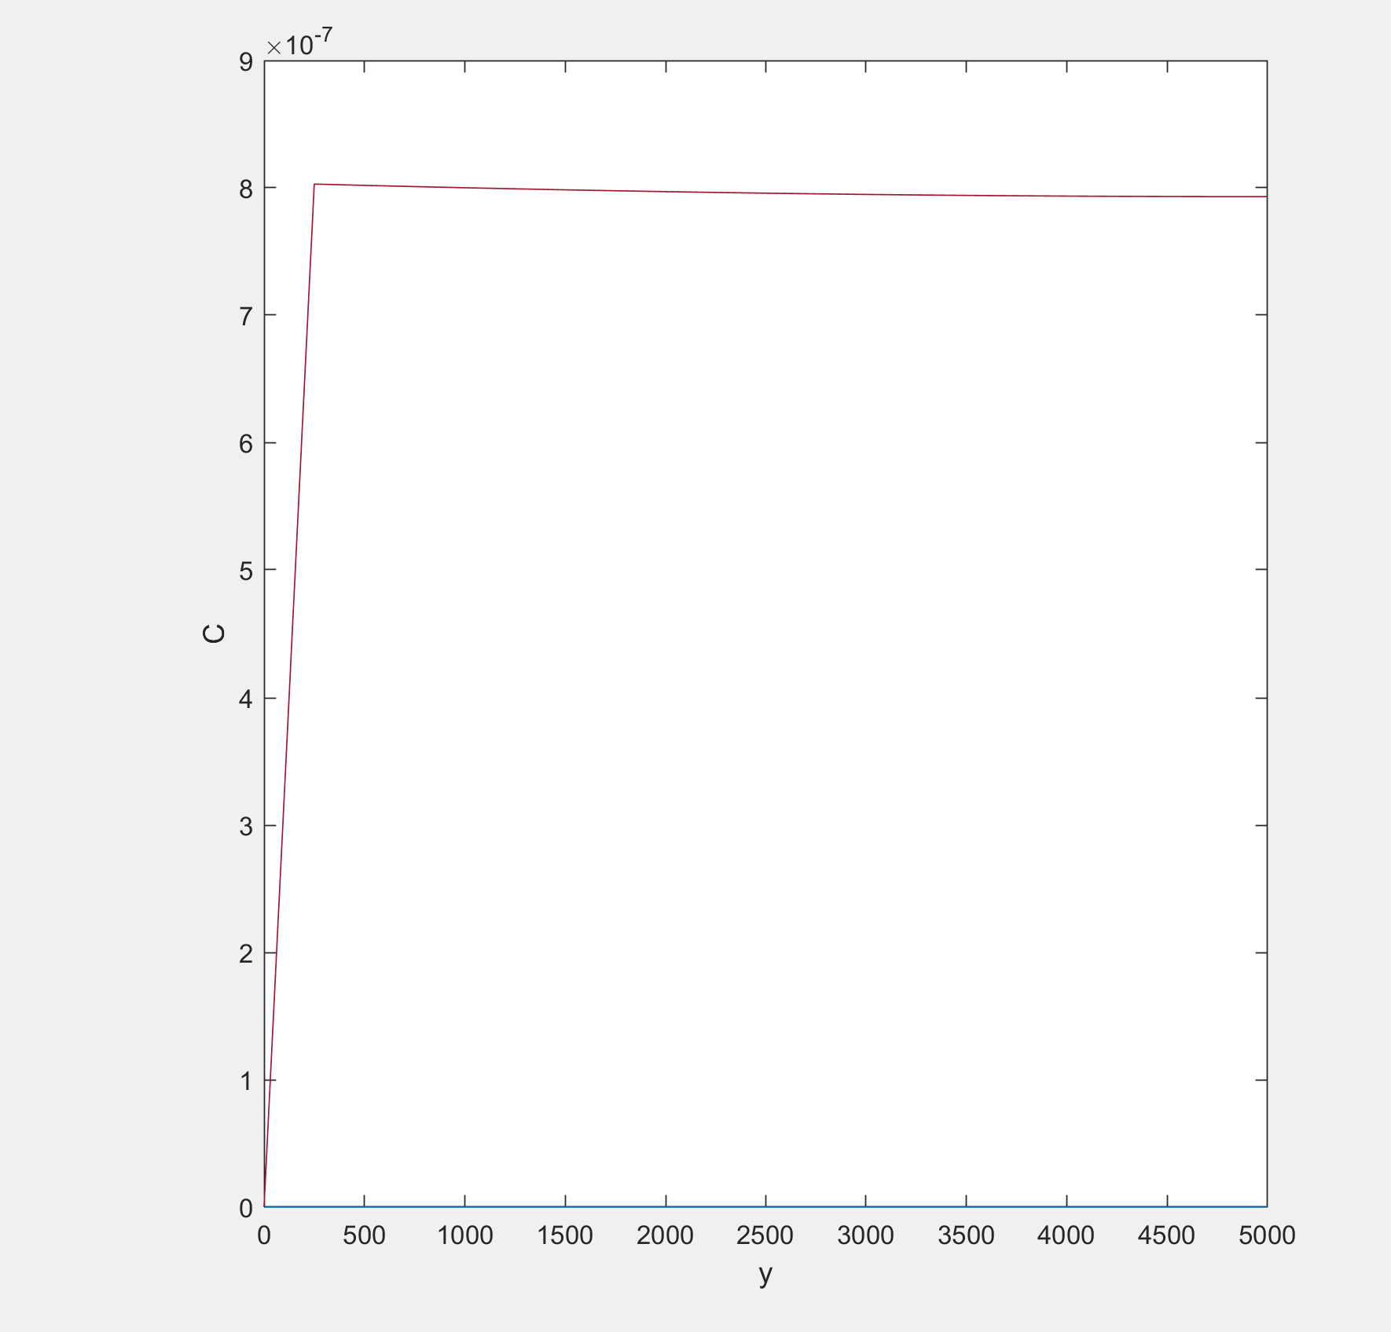
Modeling
Solution method: Implicit

Slide 27
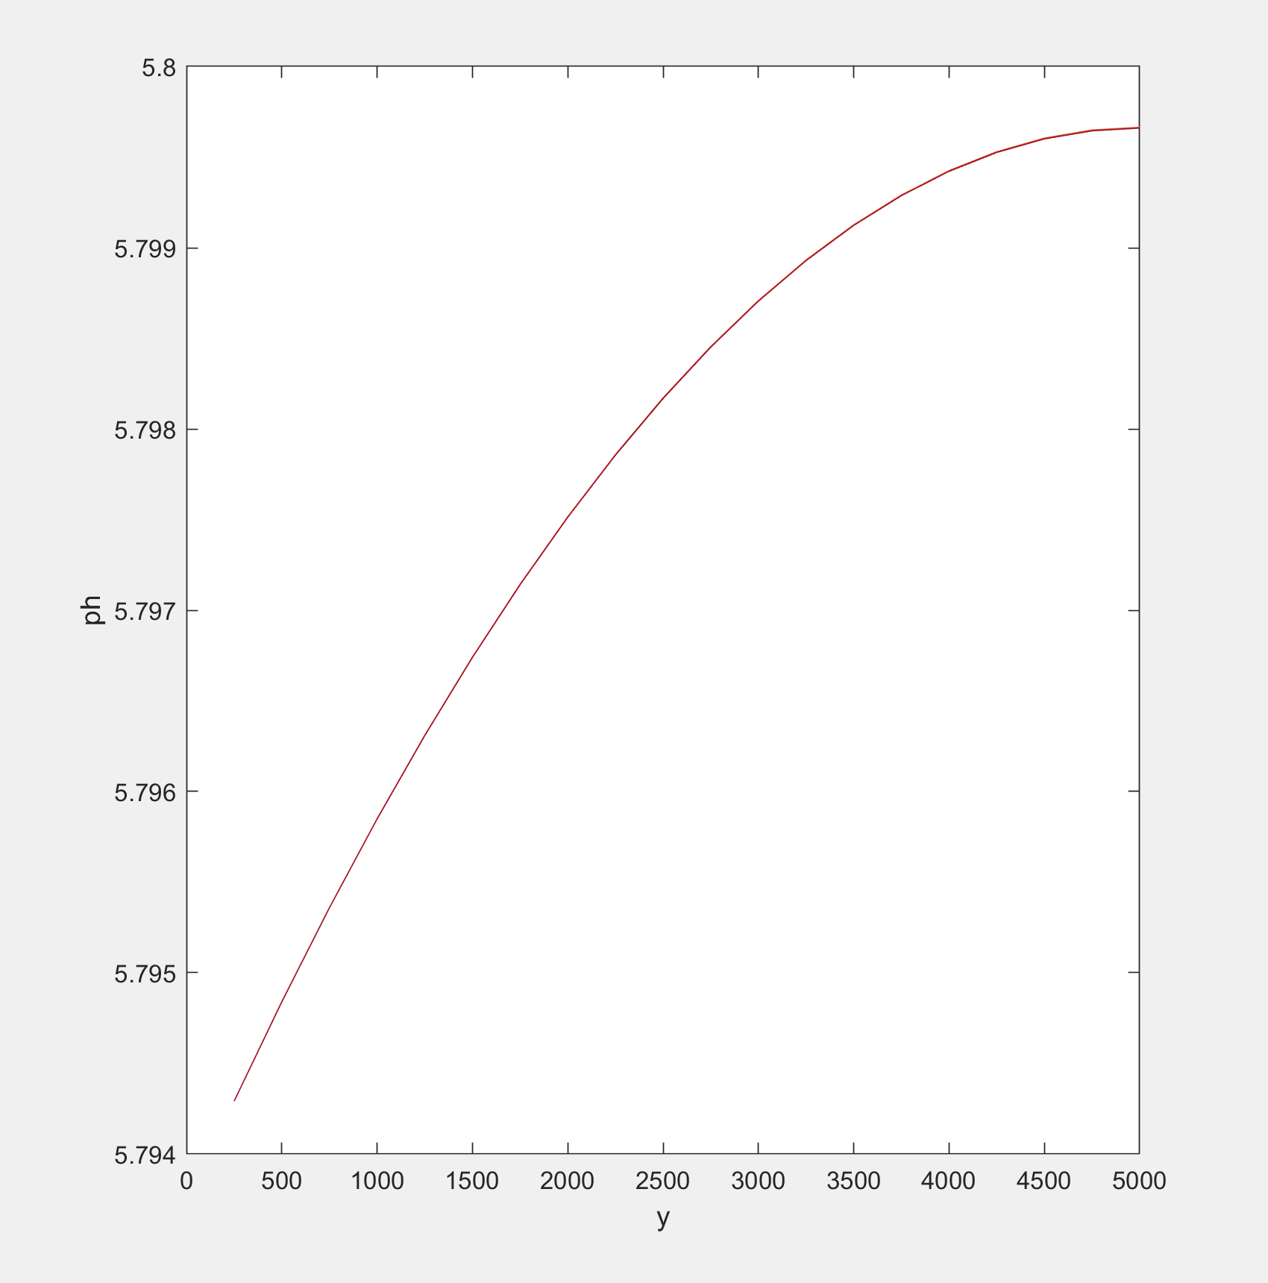
pH changes Modeling result
pH= -log(2C_{A})

Slide 28

Modeling Modeling of acid rain steady falling film (Effect of the presence of CO₂)
C_{i}= 420 ppm
D= 1.91×10⁻⁹ m²/s
K= 0.037 s⁻¹
C=ay+b , a=0.005053
u= 9 m/s

Slide 29
Modeling
Results in Minitab
Altitude [m] | CO2 [ppm]
1560 | 401.36
1797 | 400.16
2033 | 398.97
Shibata, Y., Nagasawa, C., Abo, M., Inoue, M., Morino, I., & Uchino, O. (2018). Comparison of CO2 Vertical Profiles in the Lower Troposphere between 1.6 µm Differential Absorption Lidar and Aircraft Measurements Over Tsukuba. Sensors, 18(11), 4064.

Slide 30
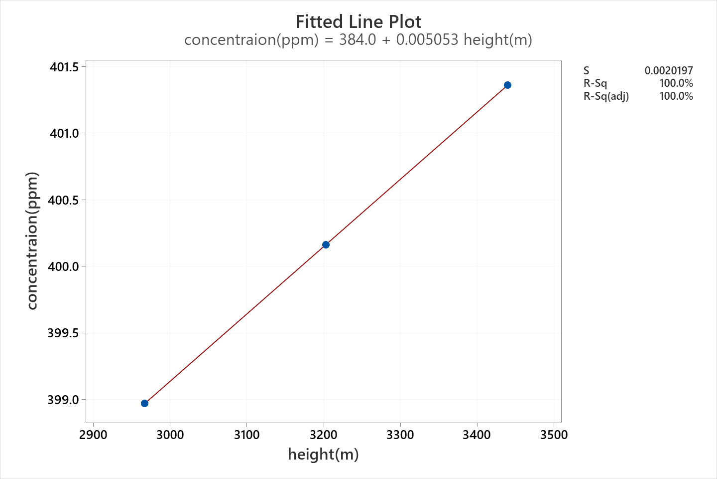
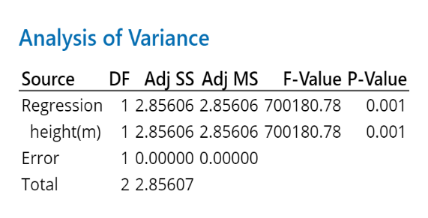
Modeling
Results in Minitab

Slide 31
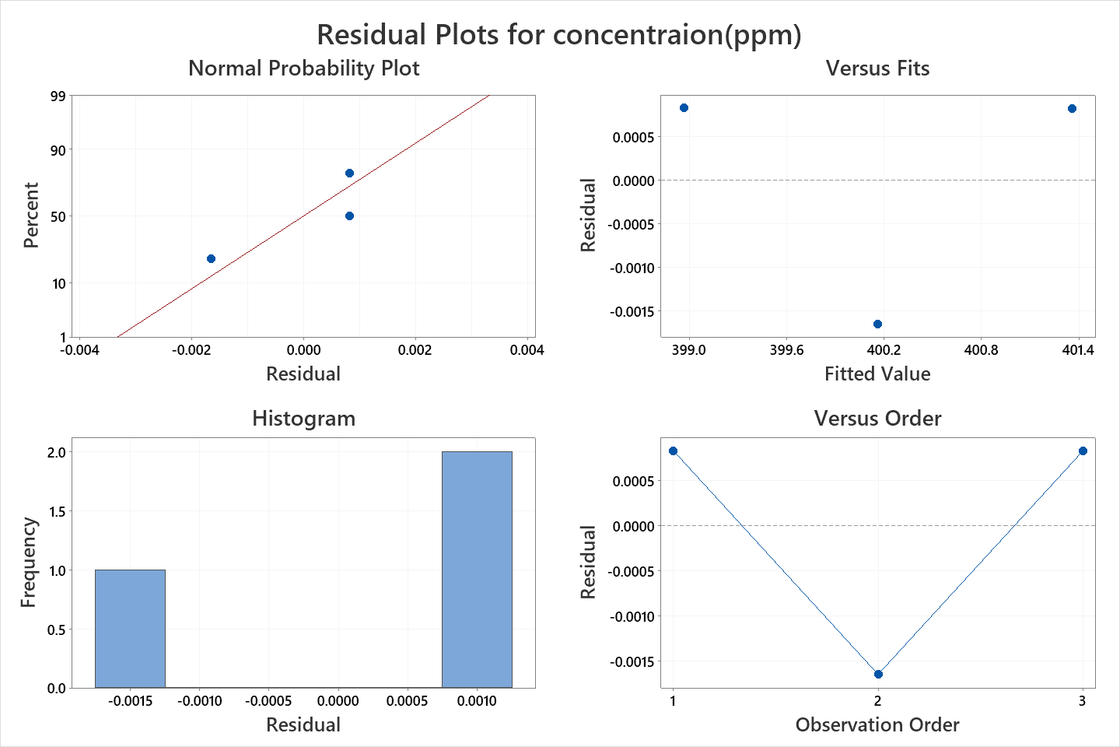
Modeling
Results in Minitab

Slide 32
Modeling

Slide 33
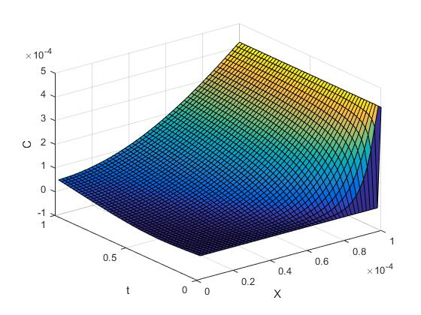
Modeling
Modeling result
Solution method: Implicit

Slide 34
Thanks for your attention

